Slide 1
NETWORK LAYER

Slide 2
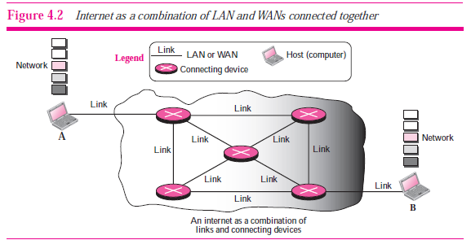

Slide 3
BASICS
SWITCHING:
the passage of a message from a source to a destination involves many decisions.
When a message reaches a connecting device, a decision needs to be made to select one of the output ports through which the packet needs to be send out.
In other words, the connecting device acts as a switch that connects one port to another port.

Slide 4
2 types of switching:
Circuit switching
Packet switching

Slide 5
Circuit switching
a physical circuit (or channel) is established between the source and destination of the message before the delivery of the message.
After the circuit is established, the entire message, is transferred from the source to the destination.
The source can then inform the network that the transmission is complete, which allows the network to open all switches and use the links and connecting devices for another connection.

Slide 6


Slide 7
PACKET SWITCHING
The network layer in the Internet today is a packet-switched network.
In this type of network, a message from the upper layer is divided into manageable packets and each packet is sent through the network.
The source of the message sends the packets one by one; the destination of the message receives the packets one by one.
The destination waits for all packets belonging to the same message to arrive before delivering the message to the upper layer.
The connecting devices in a packet-switching network still need to decide how to route the packets to the final destination. Today, a packet-switched network can use two different approaches to route the packets: the datagram approach and the virtual circuit approach. We discuss both approaches in the next section.

Slide 8


Slide 9
Packet switching at network layer (cont)
The packet-switched network layer of the Internet was originally designed as a connectionless service, but recently there is a tendency to change this to a connection oriented service. We first discuss the dominant trend and then briefly discuss the new one.

Slide 10
Initially, the network layer was designed to provide a connectionless service, in which the network layer protocol treats each packet independently, with each packet having no relationship to any other packet.
The packets in a message may or may not travel the same path to their destination.
The idea was that the network layer is only responsible for delivery of packets from the source to the destination.

Slide 11
there is no relationship between packets belonging to the same message. The switches in this type of network are called routers.
A packet belonging to a message may be followed by a packet belonging to the same message or a different message.
A packet may be followed by a packet coming from the same or from a different source.

Slide 12
Each packet is routed based on the information contained in its header: source and destination address.
The destination address defines where it should go; the source address defines where it comes from. The router in this case routes the packet based only on the destination address. The source address may be used to send an error message to the source if the packet is discarded.

Slide 13


Slide 14
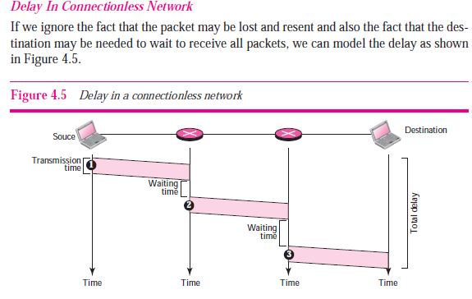

Slide 15
Connection oriented service
In a connection-oriented service, there is a relation between all packets belonging to a message.
Before all datagrams in a message can be sent, a virtual connection should be set up to define the path for the datagrams.
After connection setup, the datagrams can follow the same path.
In this type of service, not only must the packet contain the source and destination addresses, it must also contain a flow label, a virtual circuit identifier that defines the virtual path the packet should follow.

Slide 16
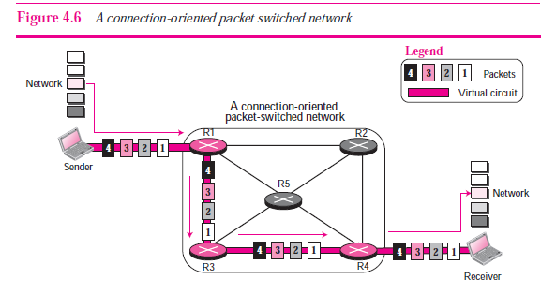

Slide 17
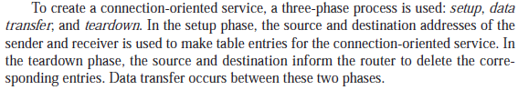

Slide 18
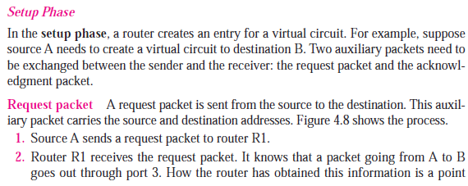

Slide 19
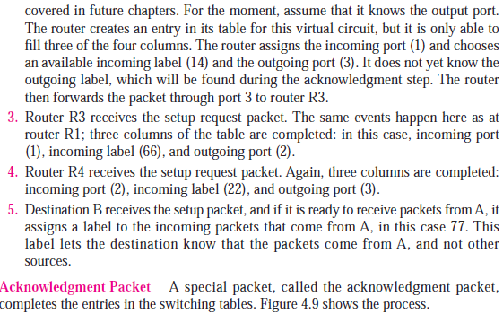

Slide 20
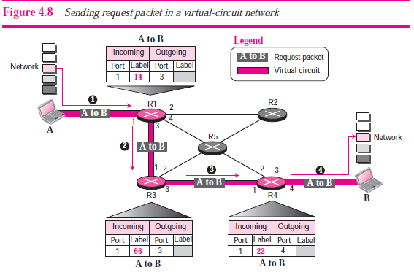

Slide 21
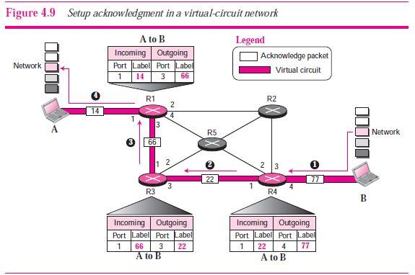

Slide 22
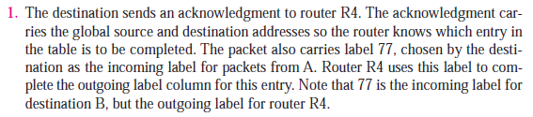
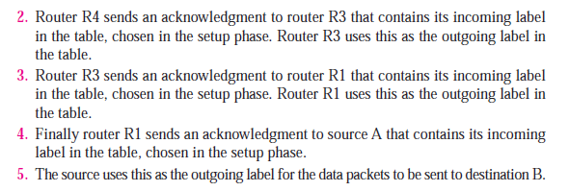

Slide 23
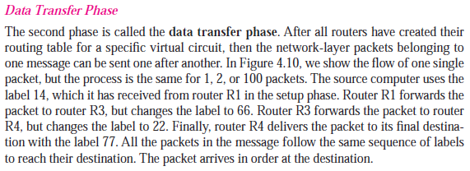

Slide 24
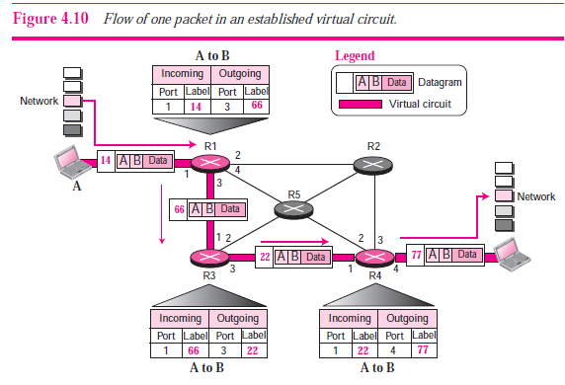

Slide 25



